Slide 1
Jenkins Integration
Continuous Integration with Jenkins
Muthukumar M - 2019

Slide 2
Improving Your Productivity
Continuous integration can help you go faster
  Detect build breaks sooner
  Report failing tests more clearly
  Make progress more visible

Slide 3

Jenkins for Continuous Integration
Jenkins – open source continuous integration server
Jenkins (http://jenkins-ci.org/) is
  Easy to install
  Easy to use
  Multi-technology
  Multi-platform
  Widely used
  Extensible
  Free

Slide 4
Jenkins for a Developer
Easy to install
  Download one file – jenkins.war
  Run one command – java –jar jenkins.war
Easy to use
  Create a new job – checkout and build a small project
  Check in a change – watch it build
  Create a test – watch it build and run
  Fix a test – check in and watch it pass
Multi-technology
  Build C, Java, C#, Python, Perl, SQL, etc.
  Test with Junit, Nunit, MSTest, Spring Test, etc.

Slide 5
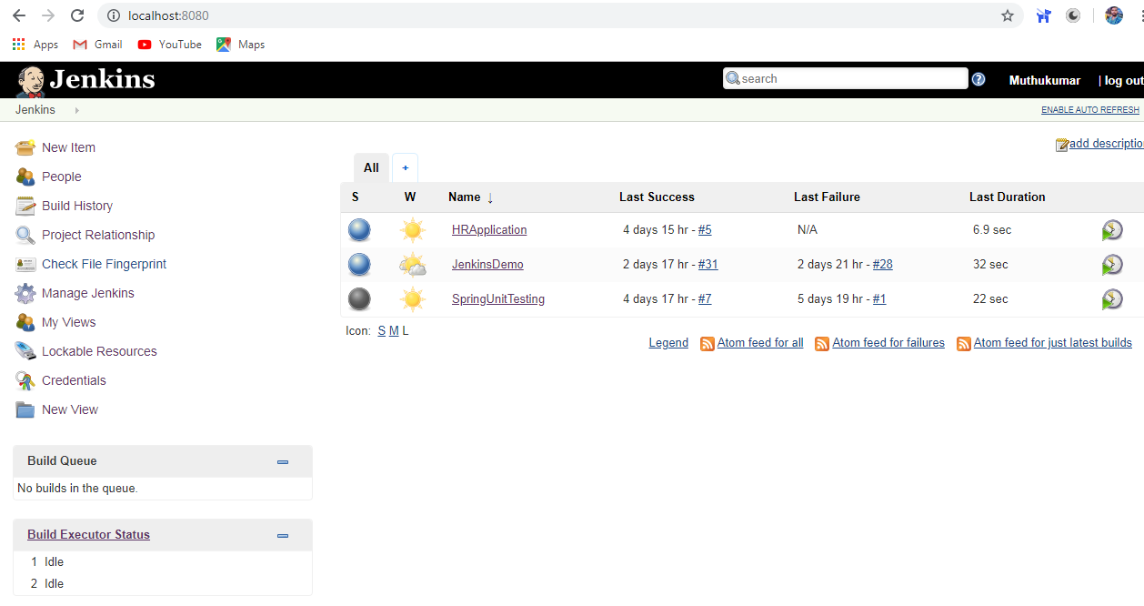
Jenkins User Interface

Slide 6
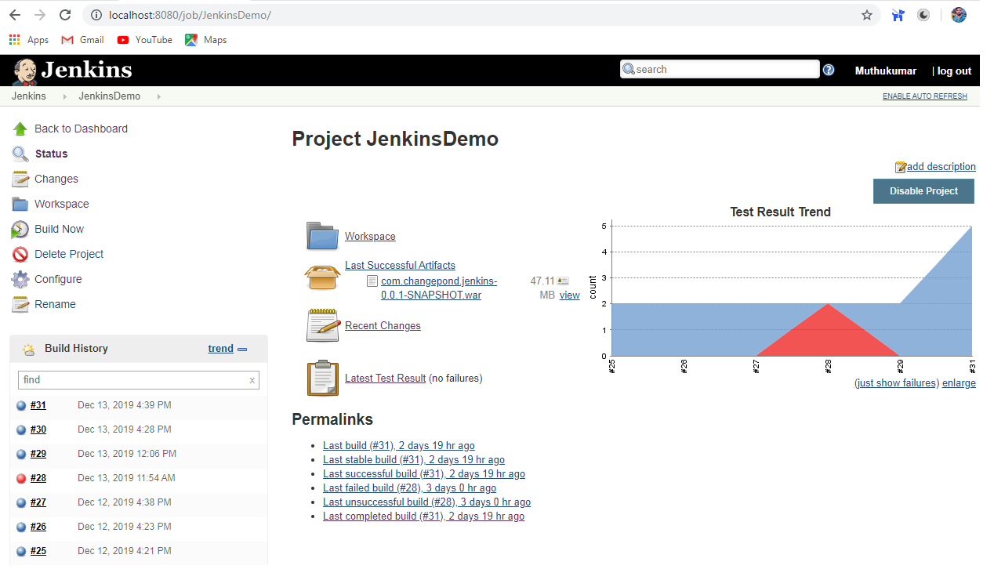
Jenkins – Display Test Report

Slide 7
Developer demo goes here…
Create a new job from a Subversion repository
Build that code, see build results
Run its tests, see test results
Make a change and watch it run through the system
Languages
  Java
  C
  Python

Slide 8
More Power – Jenkins Plugins
Jenkins has over 300 plugins
  Software configuration management
  Builders
  Test Frameworks
  Virtual Machine Controllers
  Notifiers
  Static Analyzers

Slide 9

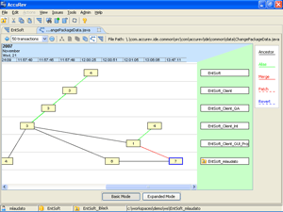
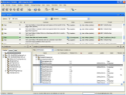




Jenkins Plugins - SCM
Version Control Systems
  Accurev
  Bazaar
  BitKeeper
  ClearCase
  Darcs
  Dimensions
  Git
  Harvest
  MKS Integrity
  PVCS
  StarTeam
  Subversion
  Team Foundation Server
  Visual SourceSafe

Slide 10
Jenkins Plugins – Build & Test
Build Tools
  Ant
  Maven
  MSBuild
  Cmake
  Gradle
  Grails
  Scons
  Groovy
Test Frameworks
  Junit
  Nunit
  MSTest
  Selenium
  Fitnesse

Slide 11
Jenkins Plugins – Analyzers
Static Analysis
  Checkstyle
  CodeScanner
  DRY
  Crap4j
  Findbugs
  PMD
  Fortify
  Sonar
  FXCop
Code Coverage
  Emma
  Cobertura
  Clover
  GCC/GCOV

Slide 12
Jenkins Plugins – Other Tools
Notification
  Twitter
  Campfire
  Google Calendar
  IM
  IRC
  Lava Lamp
  Sounds
  Speak
Authorization
  Active Directory
  LDAP
Virtual Machines
  Amazon EC2
  VMWare
  VirtualBox
  Xen
  Libvirt

Slide 13
Jenkins – Integration for You
Jenkins can help your development be
  Faster
  Safer
  Easier
  Smarter

Slide 14
Thank you
Muthukumar M

